Slide 1
Unit 8
Etiquette Guide for Writing

Slide 2
1. Common English misspelling

Slide 3
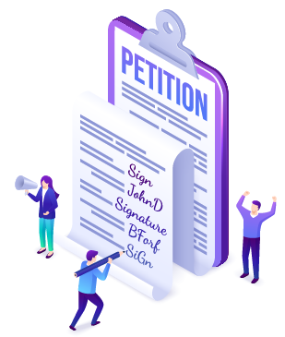
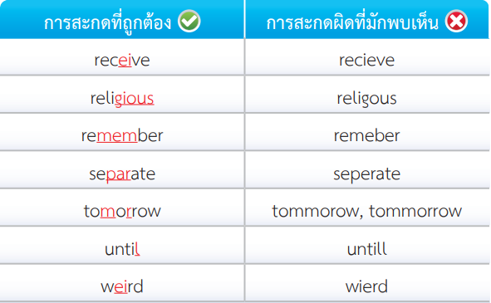
1. Common English misspelling

Slide 4
2. Confusing words

Slide 5
2. Confusing words

Slide 6
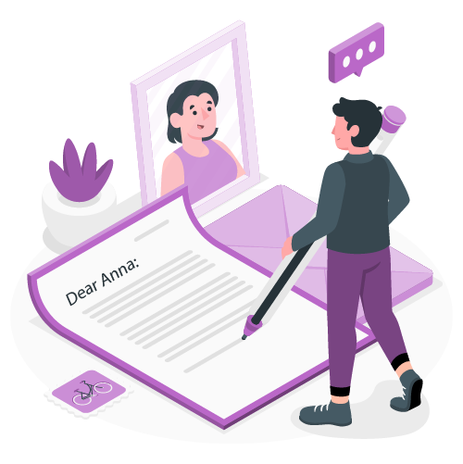
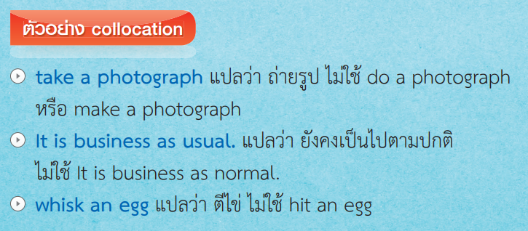
3. Collocation

Slide 7
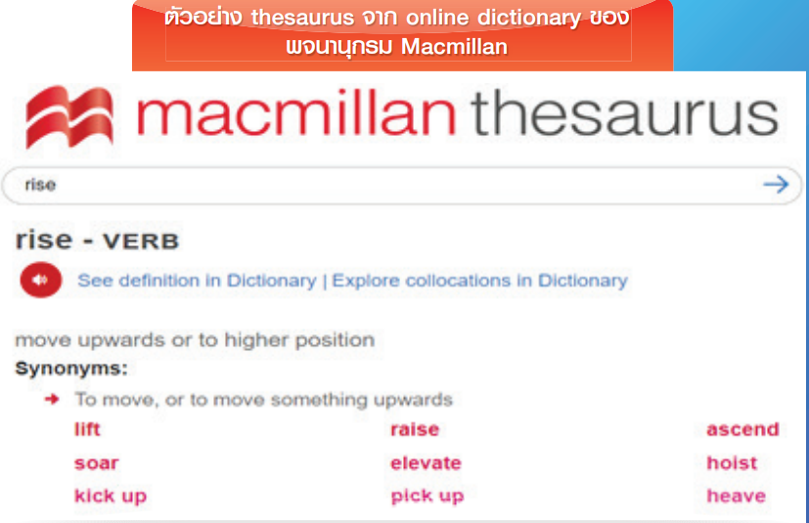
4. Synonyms

Slide 8
5. All capital letters in writing

Slide 10
6. Illegible handwriting

Slide 11
6. Illegible handwriting
Example of handwriting

Slide 12
7. Avoiding ambiguous dates
• British style: Date, month, year
• American style: Month, date, year
Example of ambiguous dates
11/12/20 --- 11 December 2021 หรือ November 12, 2021

Slide 13
8. Etiquettes for emailing

Slide 14
